Slide 1
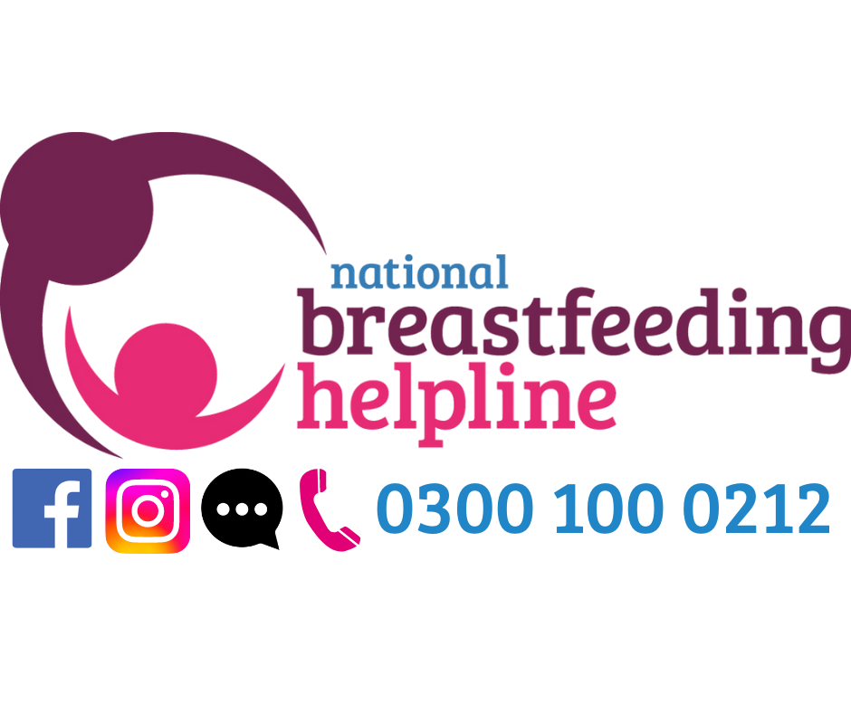




NEED BREASTFEEDING SUPPORT?
We’re here for you and your family when you need us
0300 100 0212
Funded by the Department for Health and Social Care and The Scottish Government
Calls to the Helpline cost no more than calls to UK numbers starting 01 and 02 and will be part of any inclusive minutes that apply to your provider and call package.
The National Breastfeeding Helpline is provided by the Association of Breastfeeding Mothers (registered charity in England and Wales no. 280537) and the Breastfeeding Network (a registered Charity regulated by the Scottish Charity Regulator (OSCR), Scottish Charity number SC027007) and funded by the Department for Health and Social Care and The Scottish Government. The Breastfeeding Network is a Company Limited by Guarantee Registered in Scotland Company Number 330639.

Slide 2


National Breastfeeding Helpline UK
NationalBreastfeedingHelpline
www.breastfeedingnetwork.org.uk
Evidence-based, non-judgemental and friendly breastfeeding support for all; wherever you are in your feeding journey.
Funded by the Department for Health and Social Care and The Scottish Government
Calls to the Helpline cost no more than calls to UK numbers starting 01 and 02 and will be part of any inclusive minutes that apply to your provider and call package.
The National Breastfeeding Helpline is provided by the Association of Breastfeeding Mothers (registered charity in England and Wales no. 280537) and the Breastfeeding Network (a registered Charity regulated by the Scottish Charity Regulator (OSCR), Scottish Charity number SC027007) and funded by the Department for Health and Social Care and The Scottish Government. The Breastfeeding Network is a Company Limited by Guarantee Registered in Scotland Company Number 330639.

Slide 3

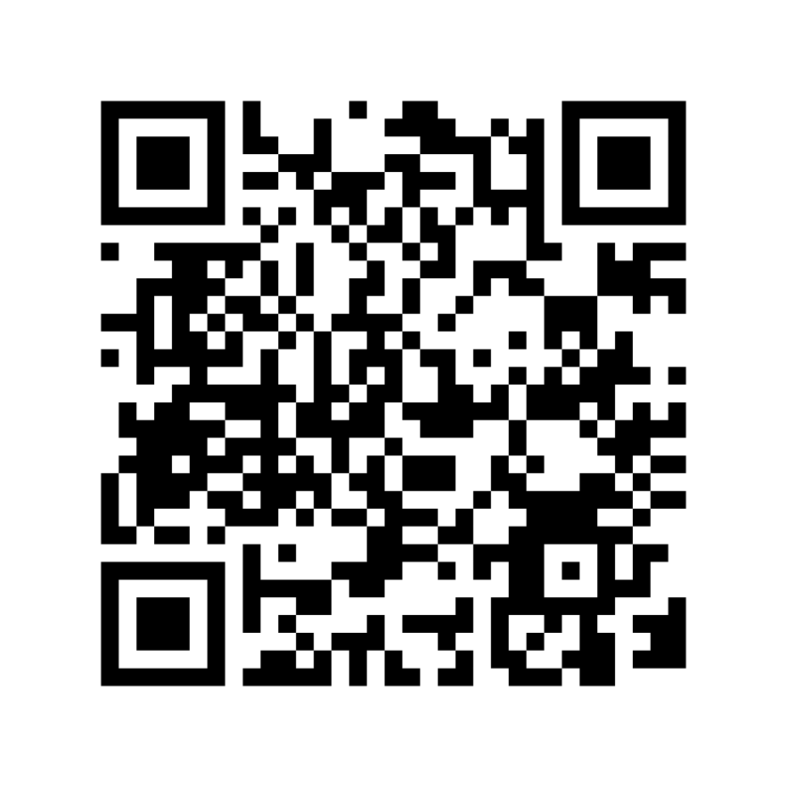
Funded by the Department for Health and Social Care and The Scottish Government
Calls to the Helpline cost no more than calls to UK numbers starting 01 and 02 and will be part of any inclusive minutes that apply to your provider and call package. The National Breastfeeding Helpline is provided by the Breastfeeding Network (a registered Charity regulated by the Scottish Charity Regulator (OSCR), Scottish Charity number SC027007) and the Association of Breastfeeding Mothers (registered charity in England and Wales no. 280537) and is funded by the Department for Health and Social Care and The Scottish Government. The Breastfeeding Network is a Company Limited by Guarantee Registered in Scotland Company Number 330639.

