Slide 1
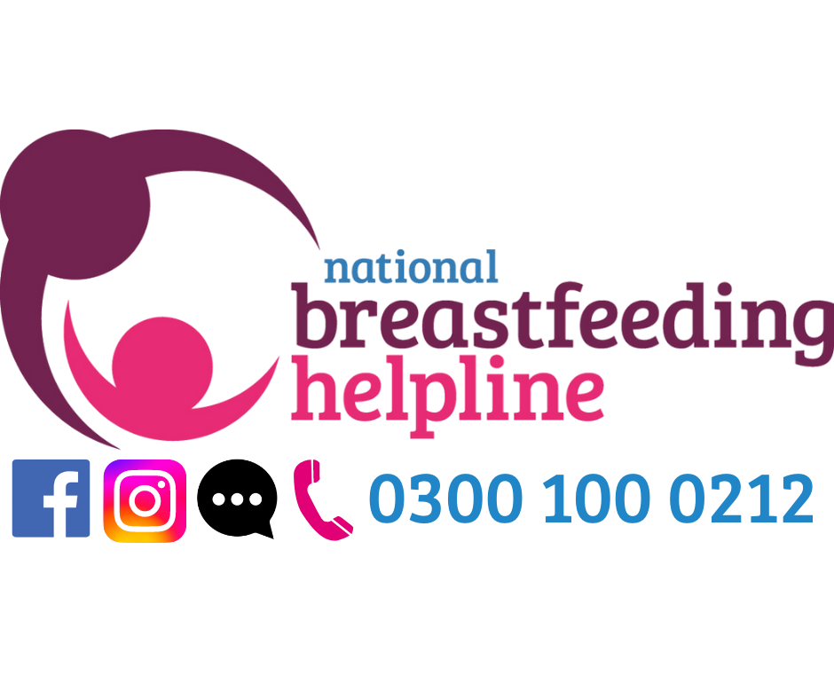




NEED BREASTFEEDING SUPPORT?
We’re here for you and your family when you need us
0300 100 0212
Funded by the Department for Health and Social Care and The Scottish Government
Calls to the Helpline cost no more than calls to UK numbers starting 01 and 02 and will be part of any inclusive minutes that apply to your provider and call package.
The National Breastfeeding Helpline is provided by the Breastfeeding Network (a registered Charity regulated by the Scottish Charity Regulator (OSCR), Scottish Charity number SC027007) and the Association of Breastfeeding Mothers (registered charity in England and Wales no. 280537), and funded by the Department for Health and Social Care and The Scottish Government. The Breastfeeding Network is a Company Limited by Guarantee Registered in Scotland Company Number 330639.

Slide 2


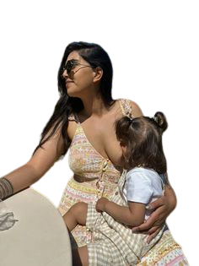
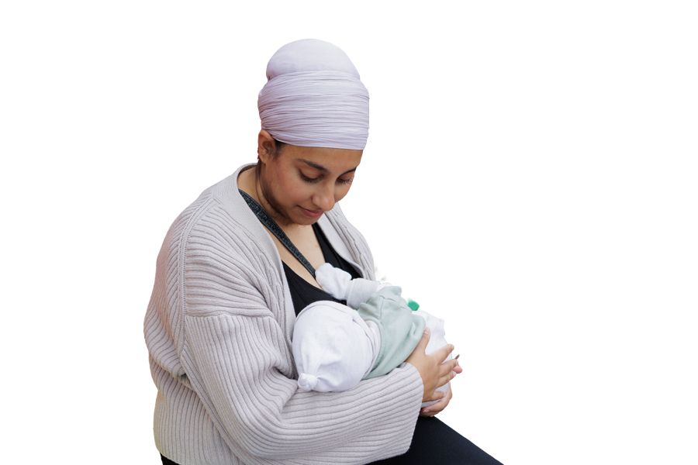
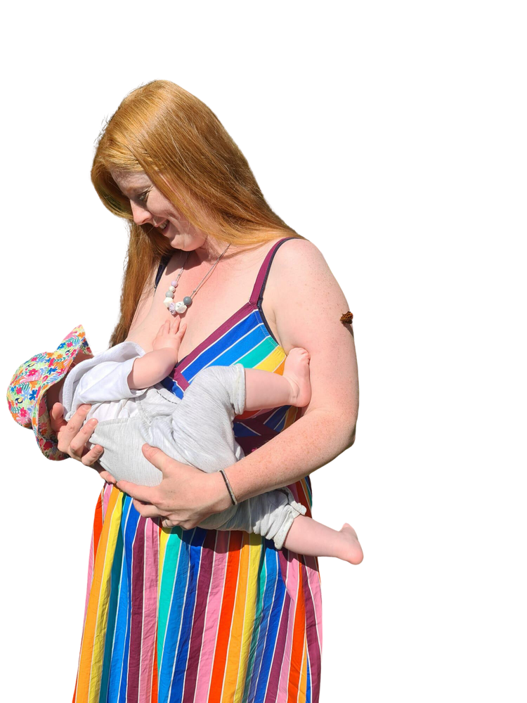

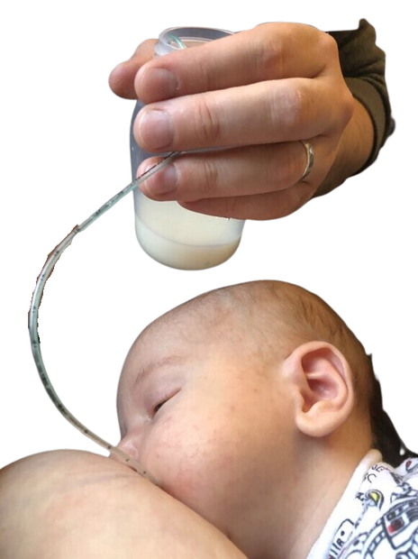

It has been very helpful, the fact that it's 24/7 is reassuring because I cannot get hold of the health visitor at this time, and getting that reassurance and support means I can make it through the night. It's such an invaluable resource and should be available for all time.
Calls to the Helpline cost no more than calls to UK numbers starting 01 and 02 and will be part of any inclusive minutes that apply to your provider and call package.
The National Breastfeeding Helpline is provided by the Breastfeeding Network (a registered Charity regulated by the Scottish Charity Regulator (OSCR), Scottish Charity number SC027007) and the Association of Breastfeeding Mothers (registered charity in England and Wales no. 280537), and funded by the Department for Health and Social Care and The Scottish Government. The Breastfeeding Network is a Company Limited by Guarantee Registered in Scotland Company Number 330639.

Slide 3
“I remember how long and lonely the nights could be when my baby was young. Knowing there’s a friendly voice waiting to take your call makes all the difference when you need some reassurance or support with feeding your baby, especially in the small hours when you feel like you’re the only person awake. ”
Calls to the Helpline cost no more than calls to UK numbers starting 01 and 02 and will be part of any inclusive minutes that apply to your provider and call package.
The National Breastfeeding Helpline is provided by the Breastfeeding Network (a registered Charity regulated by the Scottish Charity Regulator (OSCR), Scottish Charity number SC027007) and the Association of Breastfeeding Mothers (registered charity in England and Wales no. 280537), and funded by the Department for Health and Social Care and The Scottish Government. The Breastfeeding Network is a Company Limited by Guarantee Registered in Scotland Company Number 330639.

Slide 4


National Breastfeeding Helpline UK
NationalBreastfeedingHelpline
www.breastfeedingnetwork.org.uk
Evidence-based, non-judgemental and friendly breastfeeding support for all; wherever you are in your feeding journey.
Funded by the Department for Health and Social Care and The Scottish Government
Calls to the Helpline cost no more than calls to UK numbers starting 01 and 02 and will be part of any inclusive minutes that apply to your provider and call package.
The National Breastfeeding Helpline is provided by the Breastfeeding Network (a registered Charity regulated by the Scottish Charity Regulator (OSCR), Scottish Charity number SC027007) and the Association of Breastfeeding Mothers (registered charity in England and Wales no. 280537), and funded by the Department for Health and Social Care and The Scottish Government. The Breastfeeding Network is a Company Limited by Guarantee Registered in Scotland Company Number 330639.

Slide 5

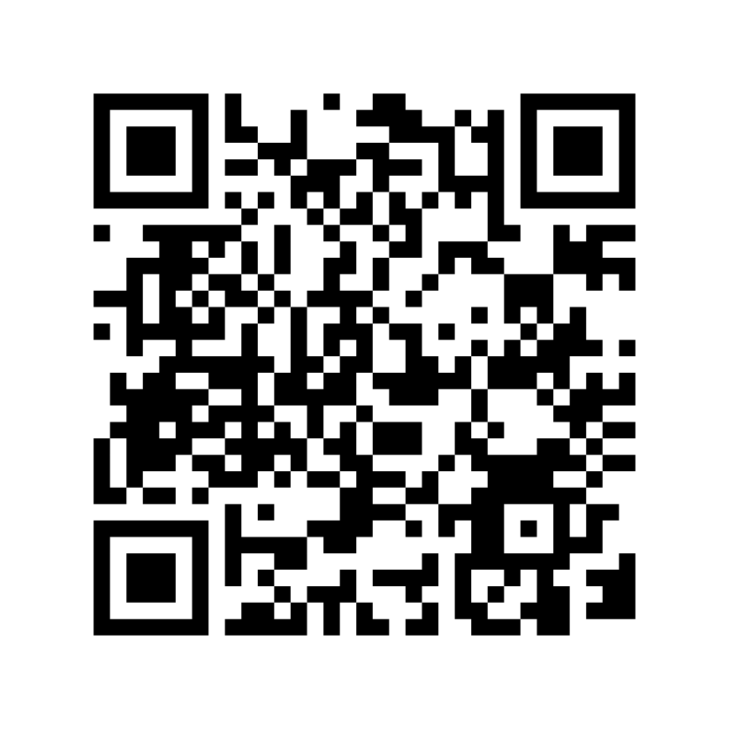
Funded by the Department for Health and Social Care and The Scottish Government
Calls to the Helpline cost no more than calls to UK numbers starting 01 and 02 and will be part of any inclusive minutes that apply to your provider and call package.
The National Breastfeeding Helpline is provided by the Breastfeeding Network (a registered Charity regulated by the Scottish Charity Regulator (OSCR), Scottish Charity number SC027007) and the Association of Breastfeeding Mothers (registered charity in England and Wales no. 280537), and funded by the Department for Health and Social Care and The Scottish Government. The Breastfeeding Network is a Company Limited by Guarantee Registered in Scotland Company Number 330639.

